Slide 1
Mechanics
NE 591

Slide 2
Last Time
Solid mechanics predicts the deformation of a body from its applied load
The strain defines the deformation
The stress defines the material’s response to the strain
Materials can have recoverable and permanent deformation
Elastic deformation is recoverable and occurs due to the stretching of the atomic lattice
Plastic deformation is permanent and results form the breaking of bonds

Slide 3
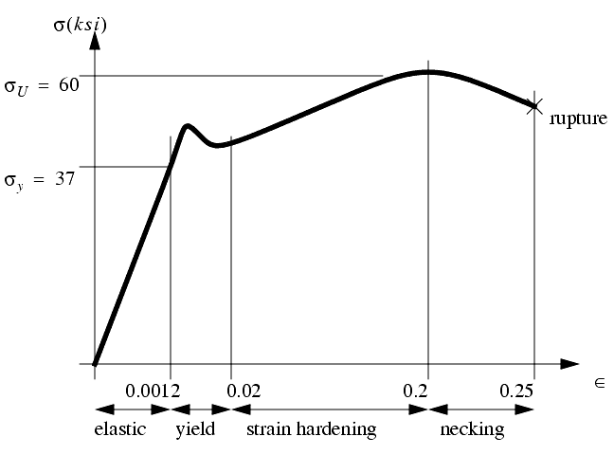
Stress/Strain Regions
Once the stress reaches the yield stress, it plastically deforms
σ_{y} is the yield stress
σ_{U} is the ultimate tensile stress
The final stress before rupture is called the fracture stress

Slide 4
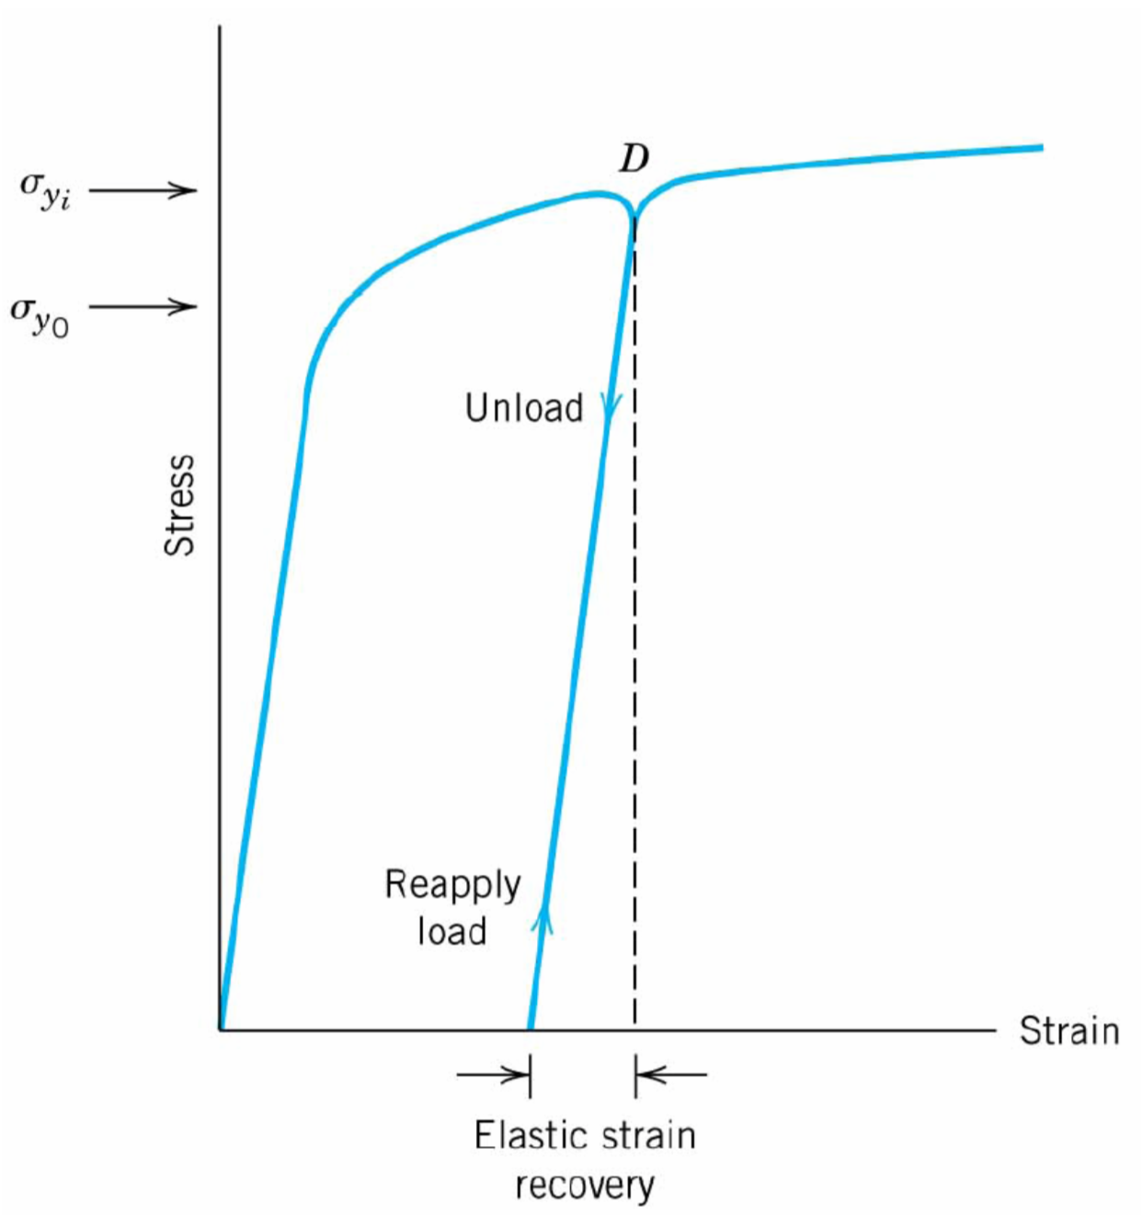
Permanent Strain
After plastic deformation, if you unload the sample, it still has the permanent strain
After unloading, the strain hardening has changed the material
Thus, if you reload, the yield strain is often higher than it was previously

Slide 5
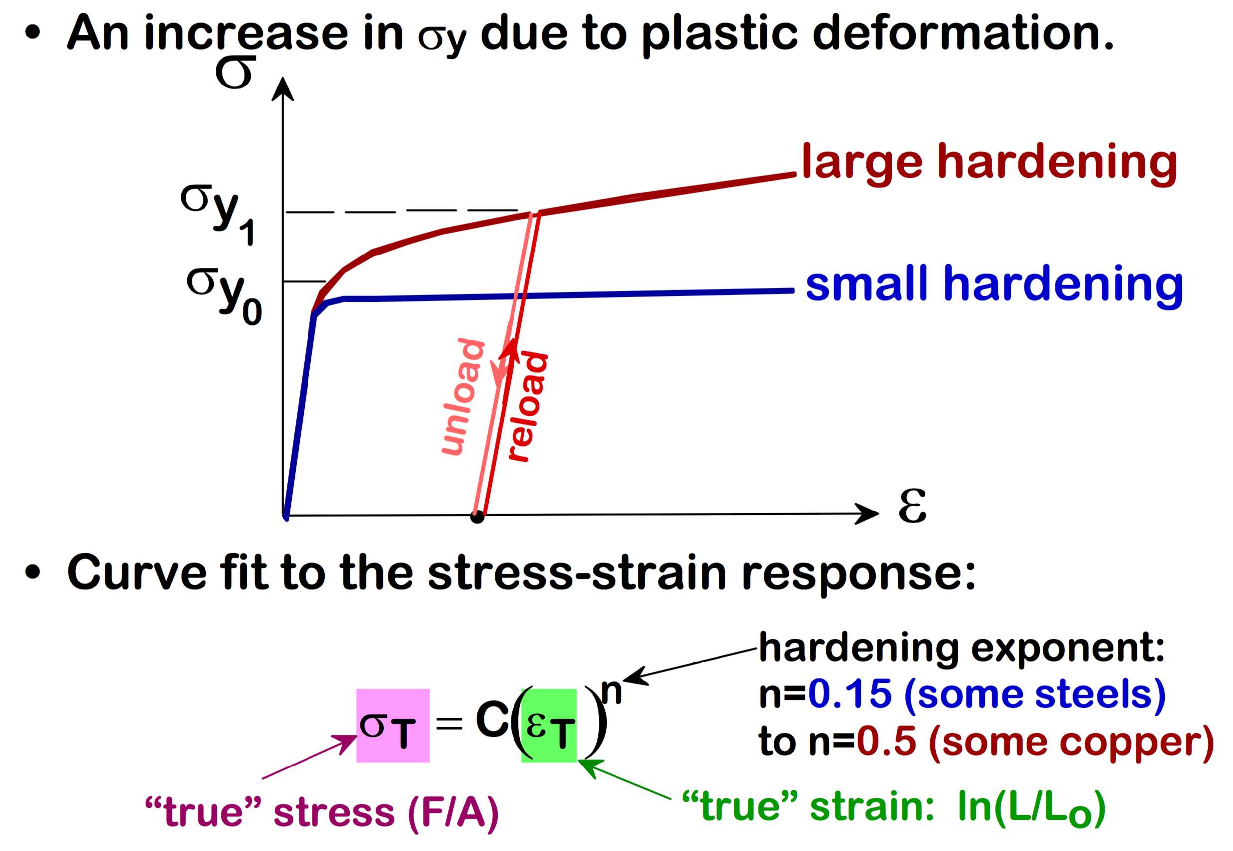
The hardening behavior changes for different materials

Slide 6
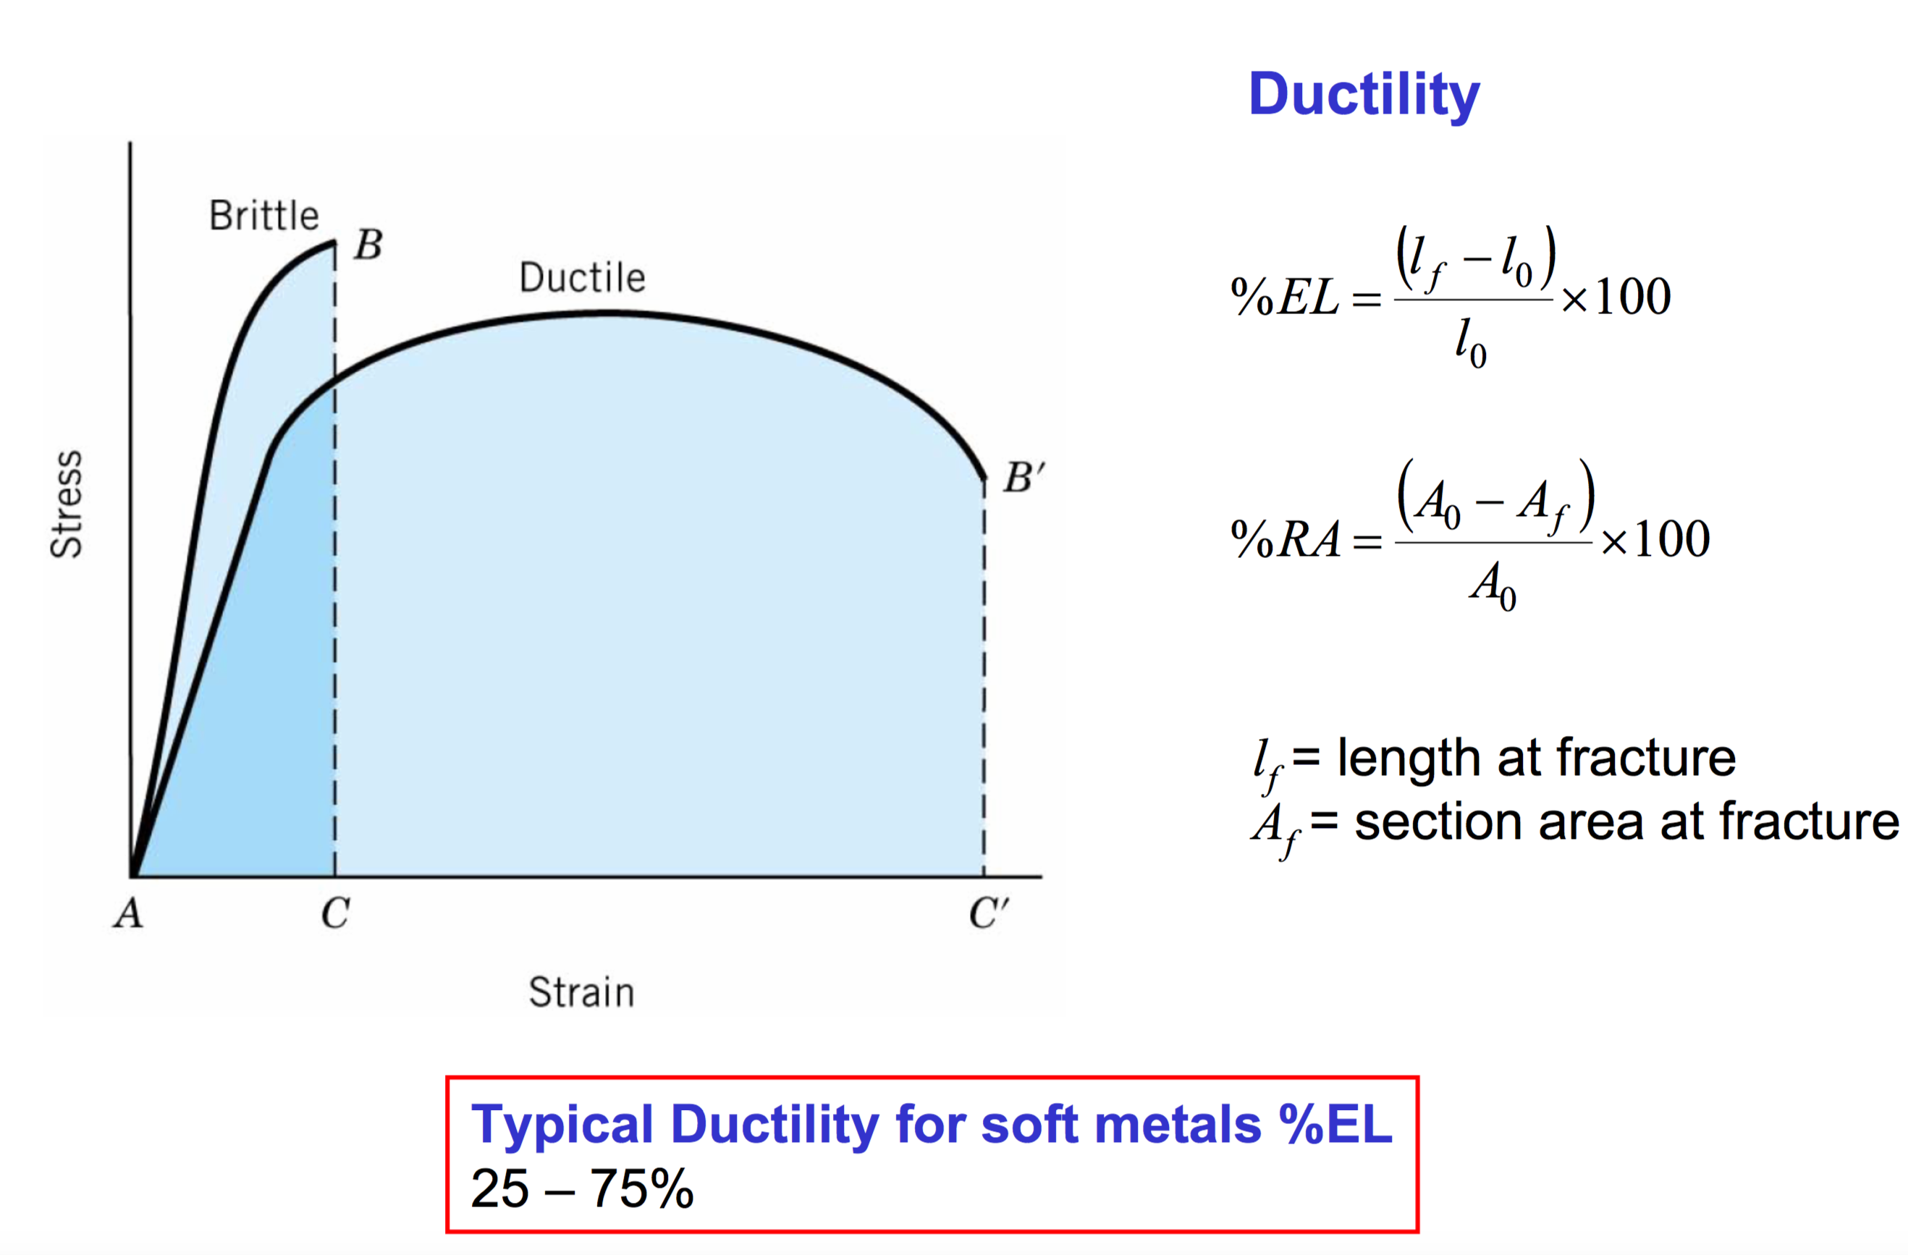
Ductile materials plastically deform significantly, brittle materials do not

Slide 7
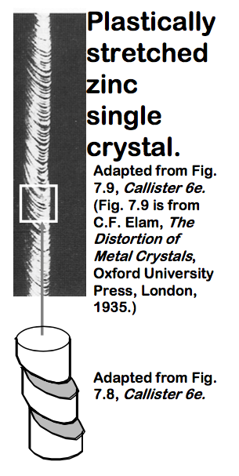
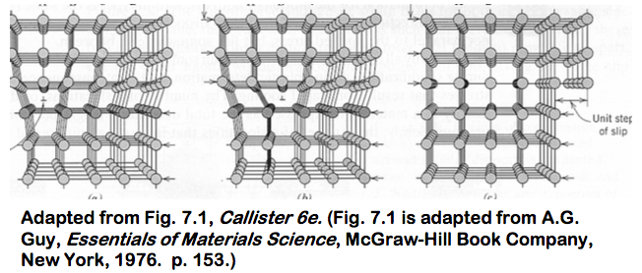
Dislocation motion
Plastic deformation occurs due to dislocation motion
A dislocation is a line defect
Edge and screw type
When it moves, only a small number of bonds are broken at a time

Slide 8

Dislocation are produced during deformation

Slide 9

Dislocation motion causes plastic deformation, dislocation pileup causes hardening

Slide 10
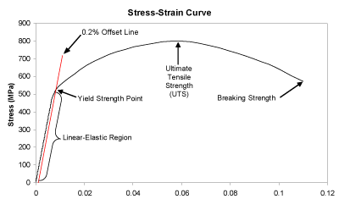
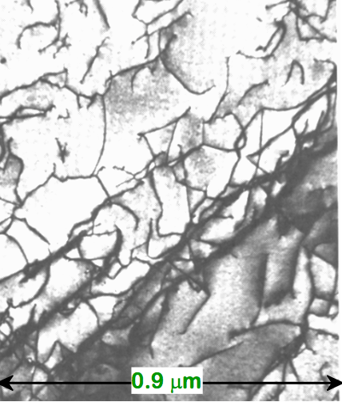
As the dislocation density increases, dislocations cannot move freely, raising the yield stress

Slide 11
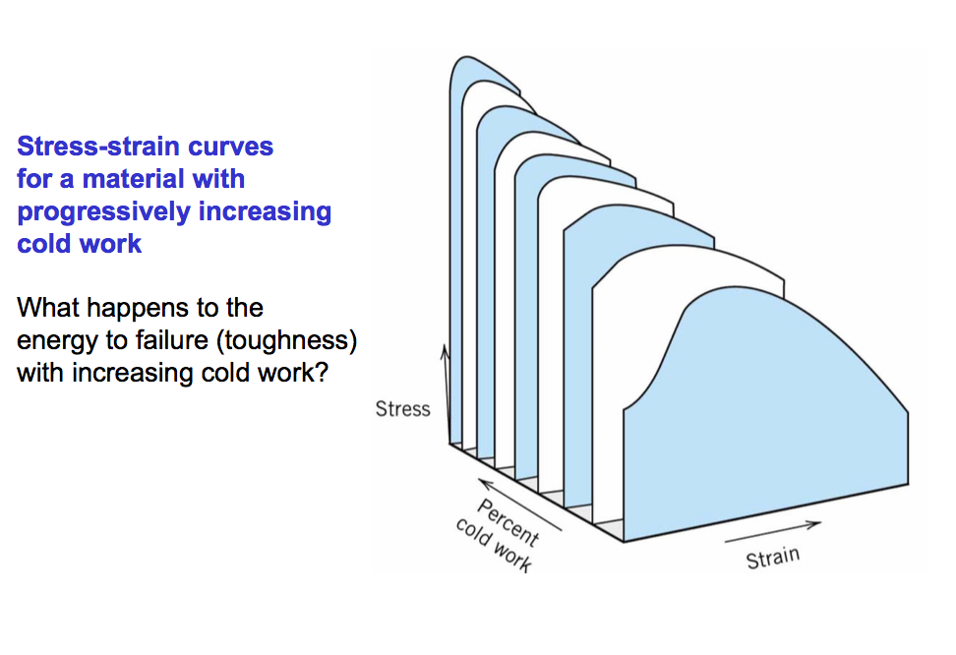
As the strength increases due to dislocation pile-up, the ductility decreases

Slide 12
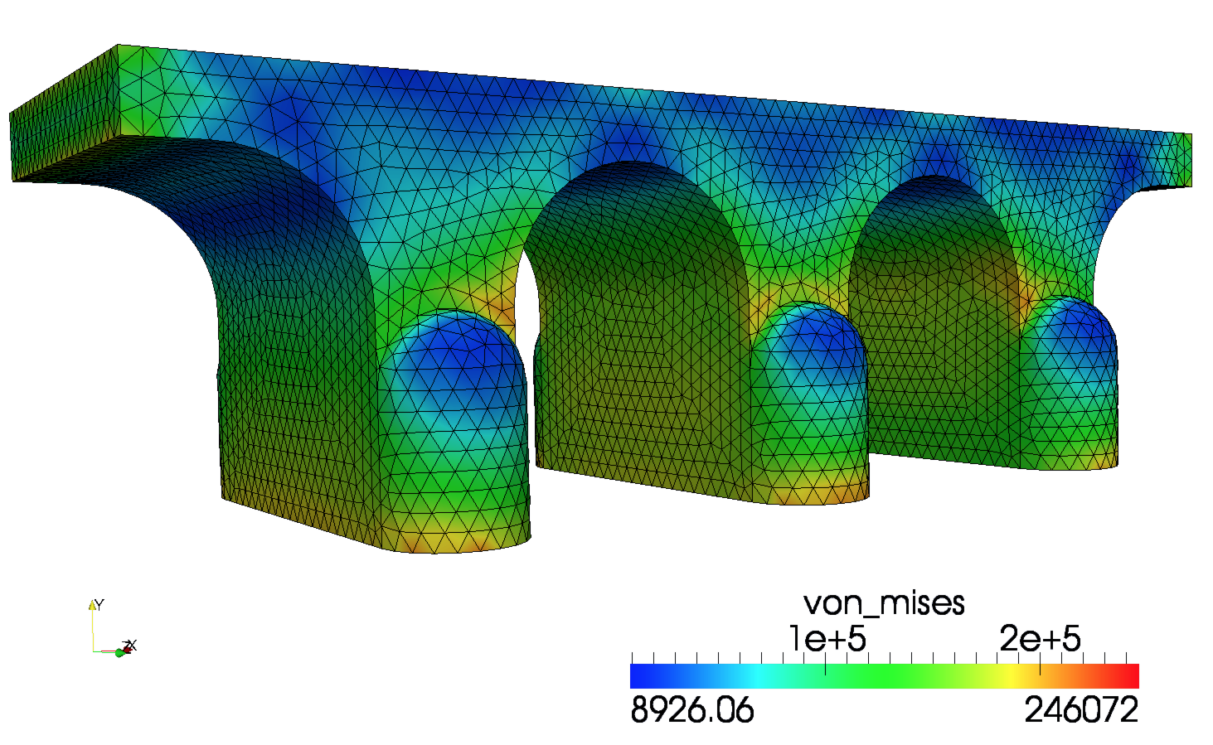
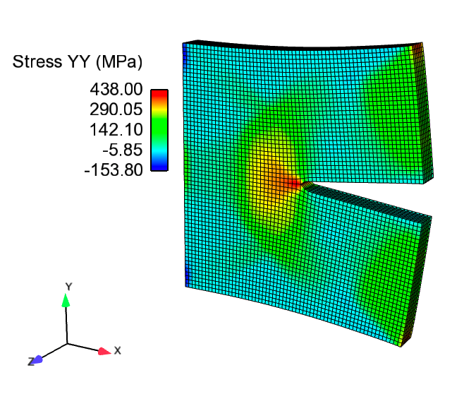
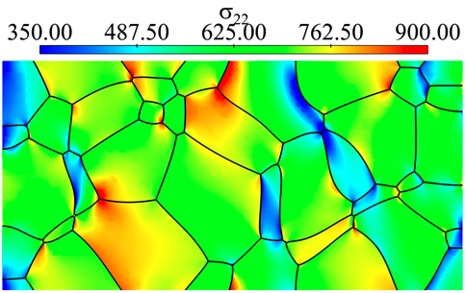
We need to determine the stress and strain throughout a body

Slide 13
Cauchy momentum equation
In this equation, u is the displacement vector, ρ is the density, σ is the stress, and g is the acceleration of gravity.
Often, we are determining the stress and strain in a static body. So the equation becomes:
Finally, we can simplify things more by making our first assumption: the impact of gravity is negligible

Slide 14
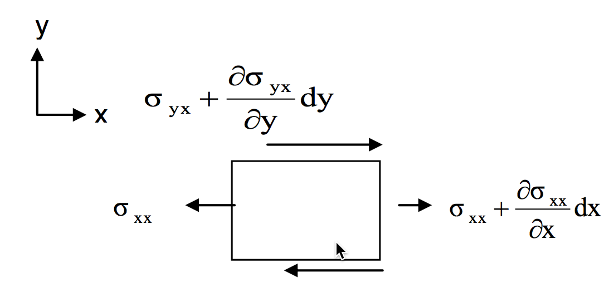
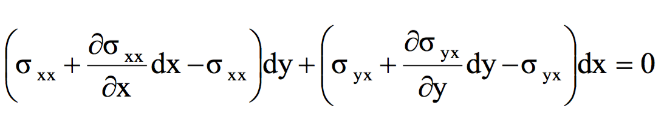
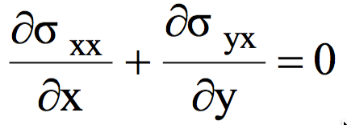
The stress divergence equation is really just a force balance

